Slide 1

Welcome to New Lodge Nursery School

Slide 2
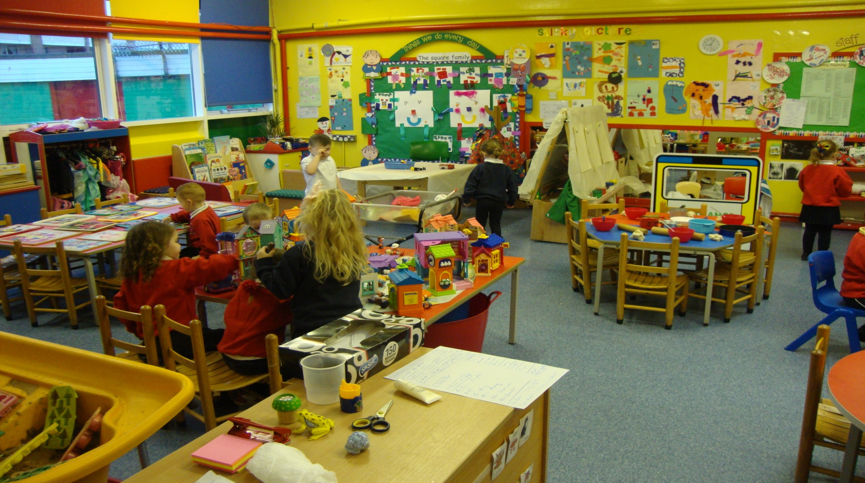
Well equipped Nursery School:
Room1

Slide 3
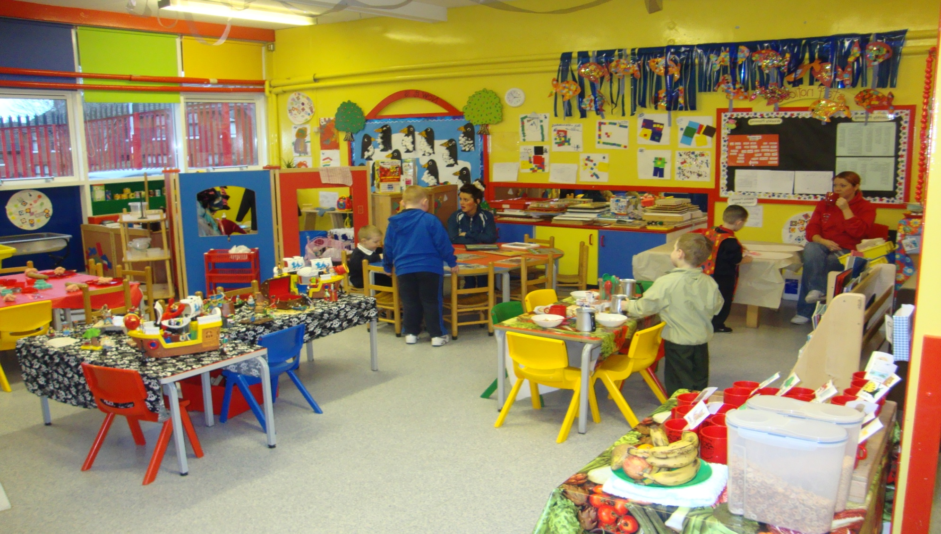
Room 2

Slide 4
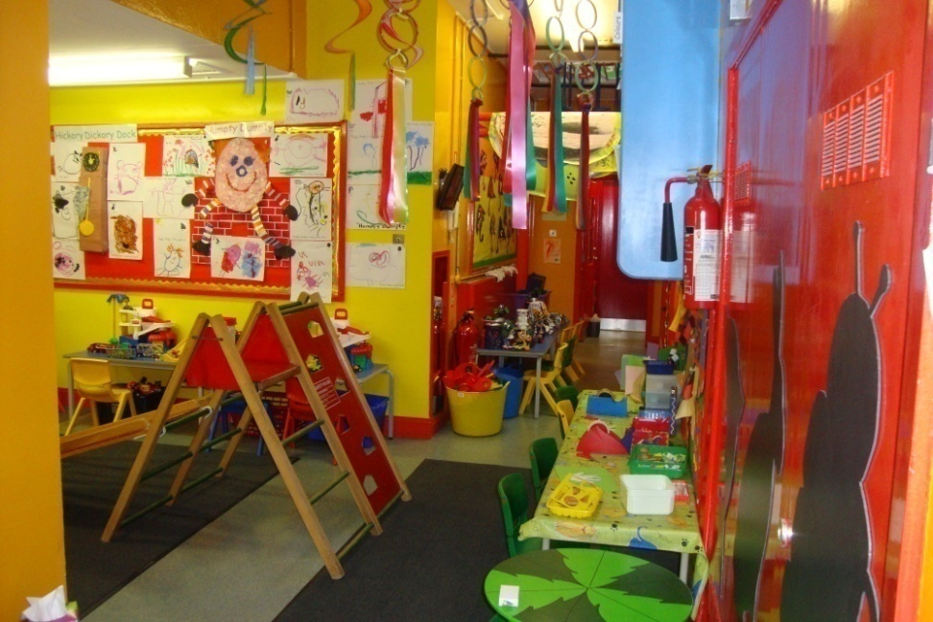
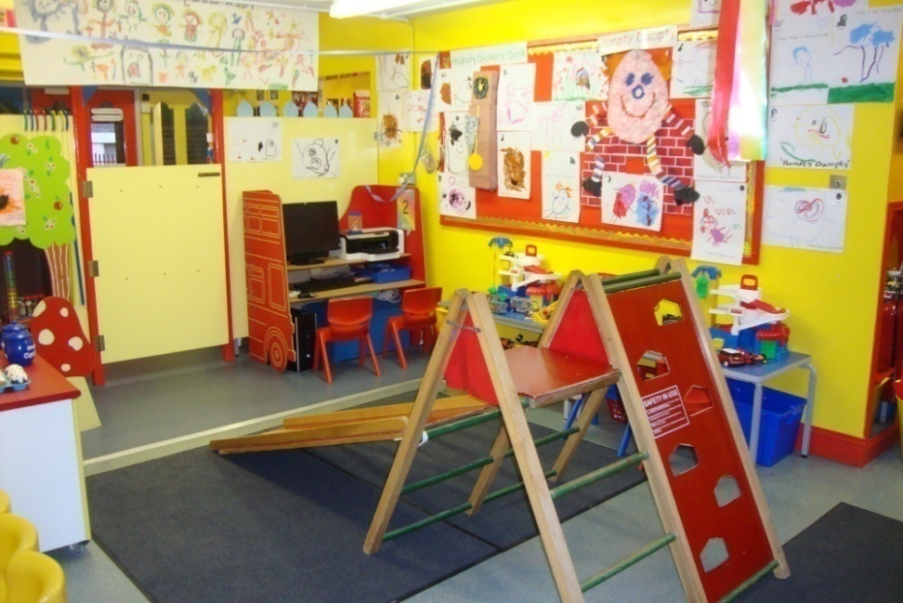
Hall

Slide 5
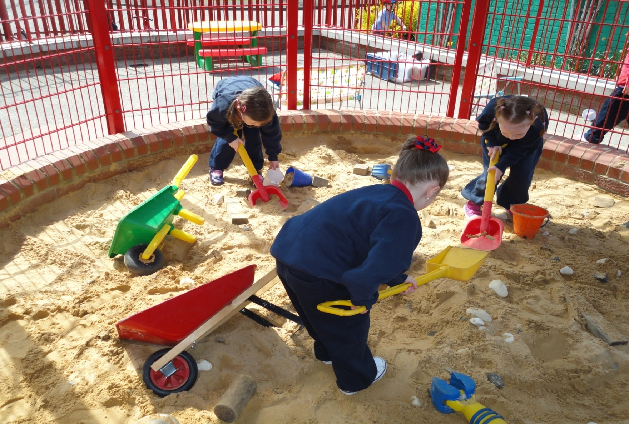
Outside Playground

Slide 6
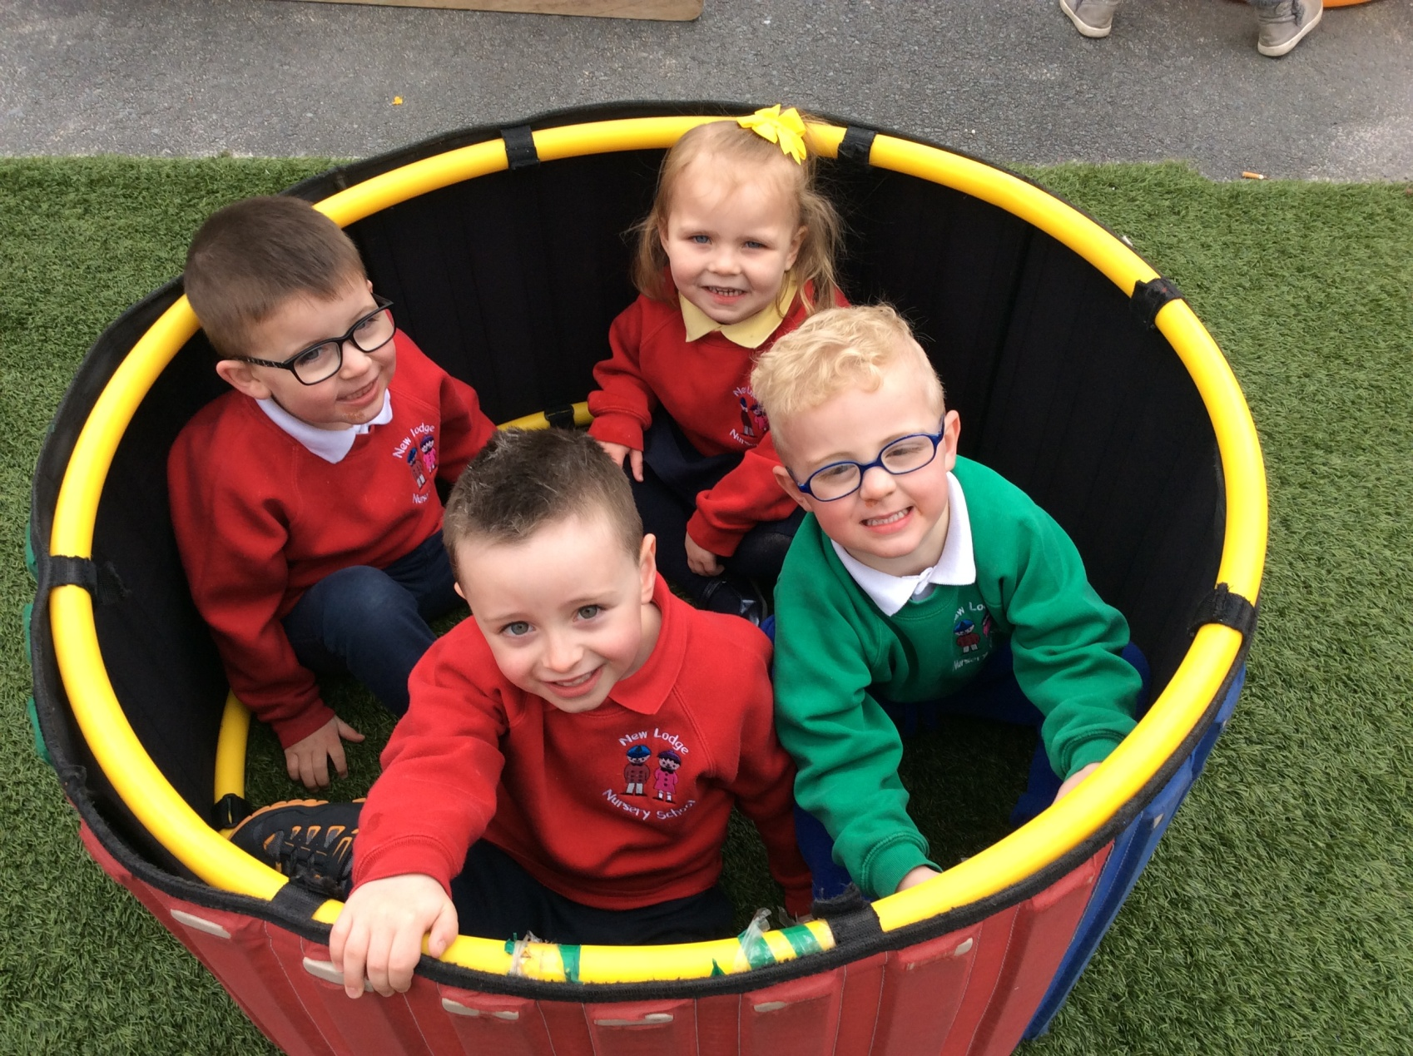
Outside Playground

Slide 7
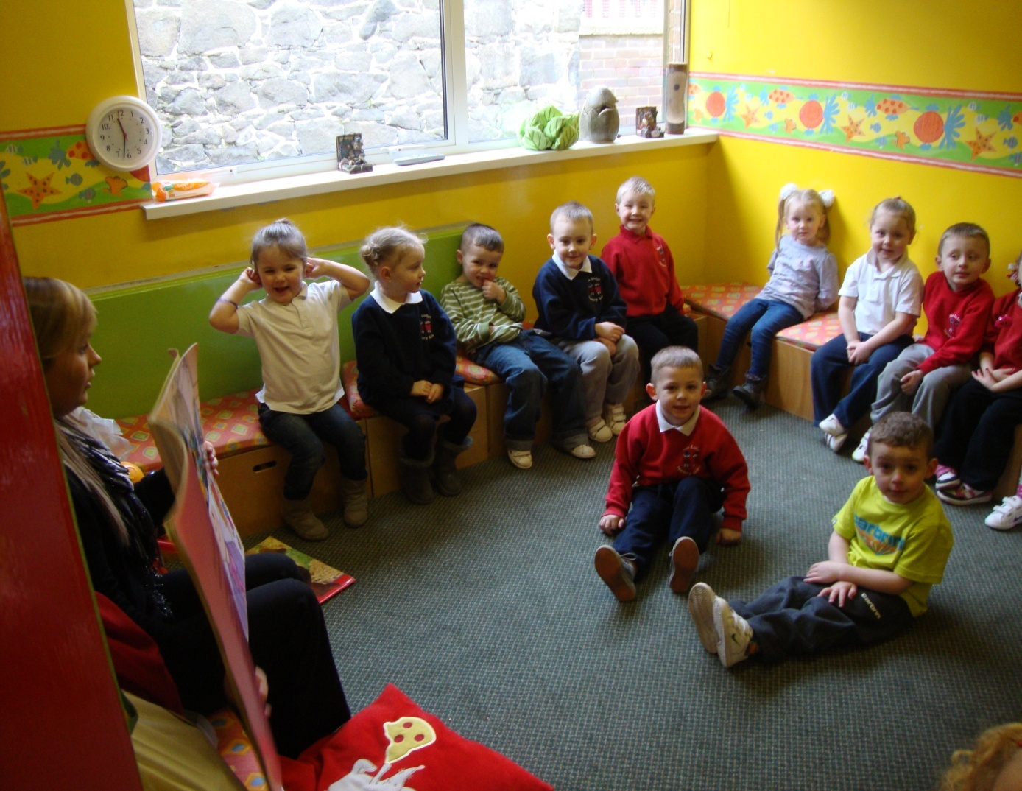
Quiet Room

Slide 8
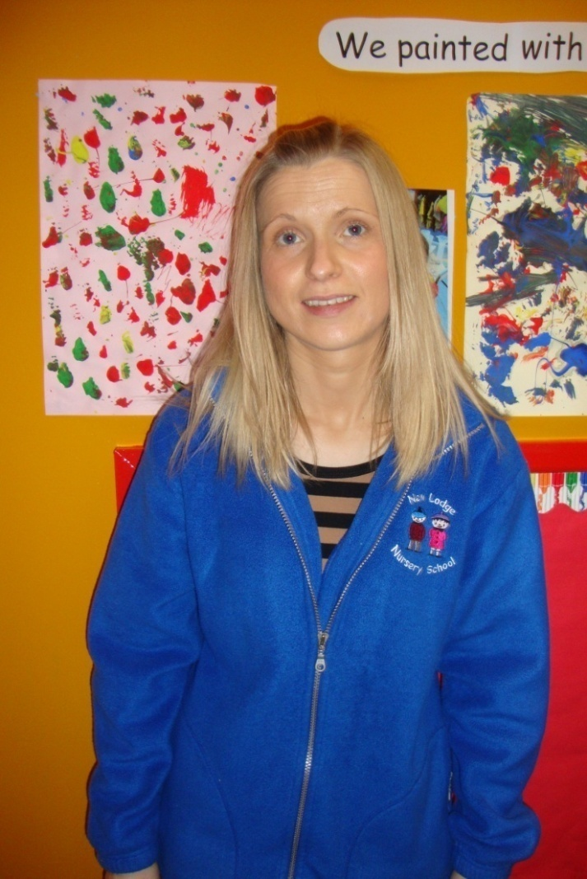
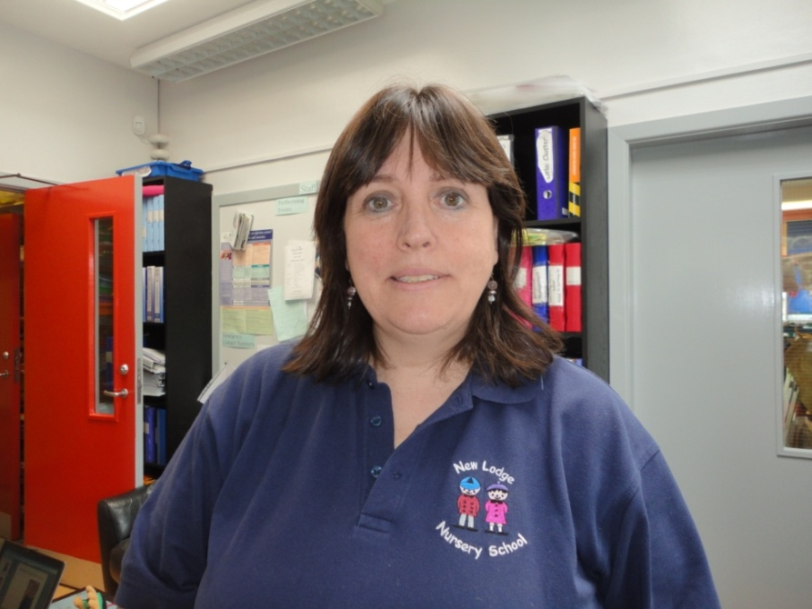
Staff: Mrs O’ Reilly & Mrs Doherty

Slide 9
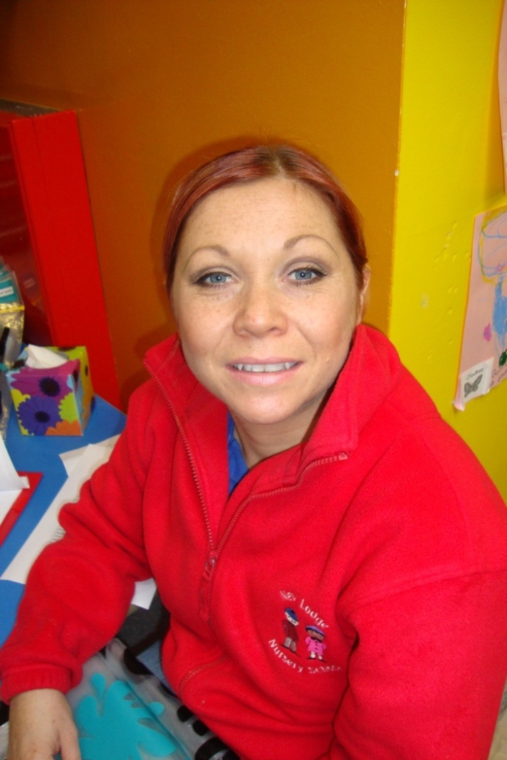
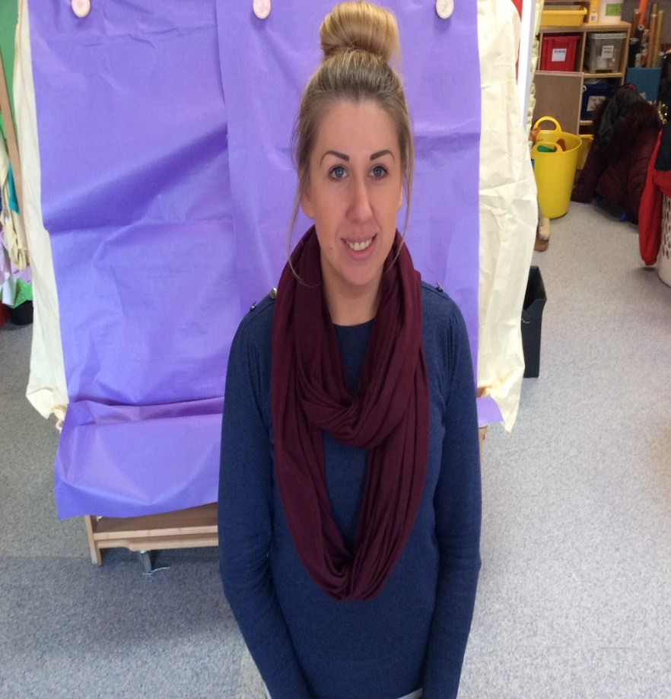
Miss McCann & Mrs Noble

Slide 10
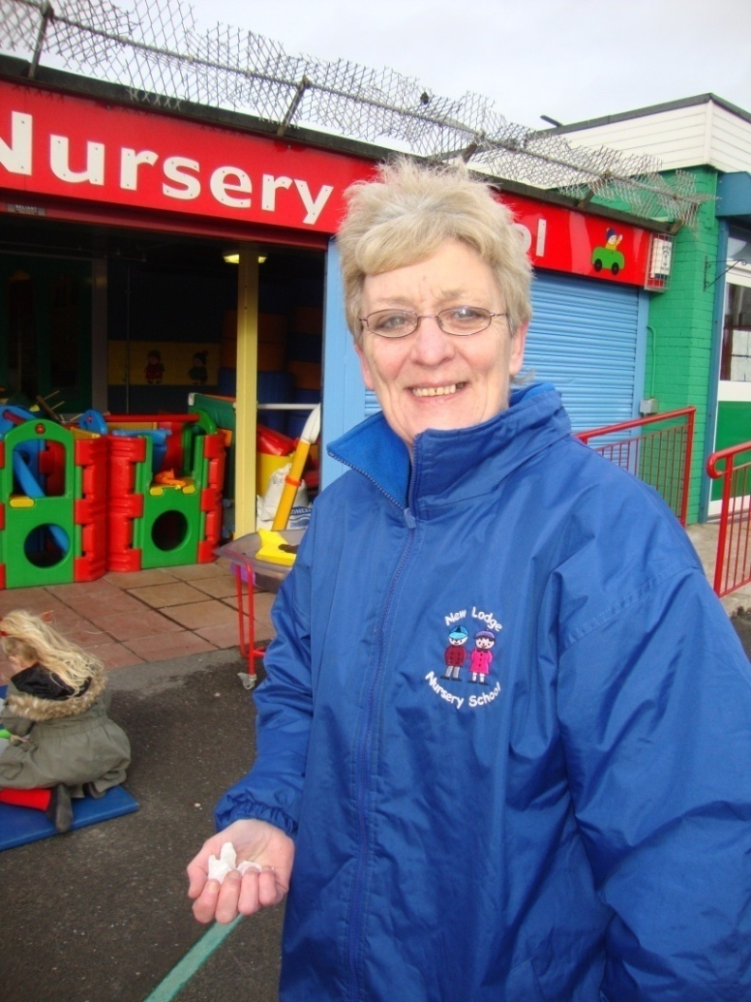
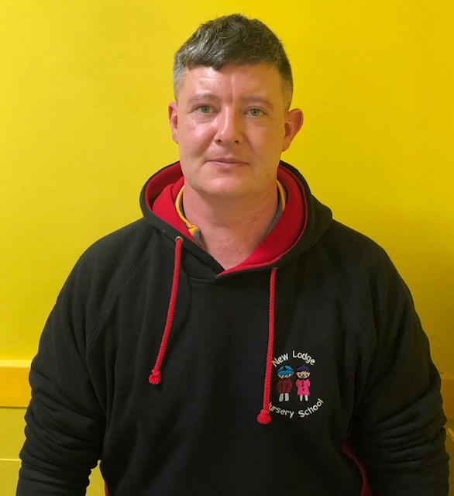
Mrs Manning & Mr Shannon

Slide 11
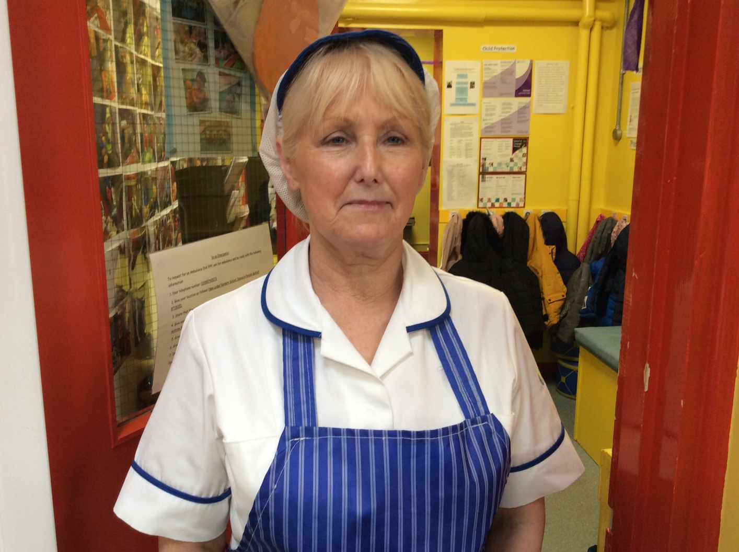
Mrs Morrow: Dining Assistant

Slide 12
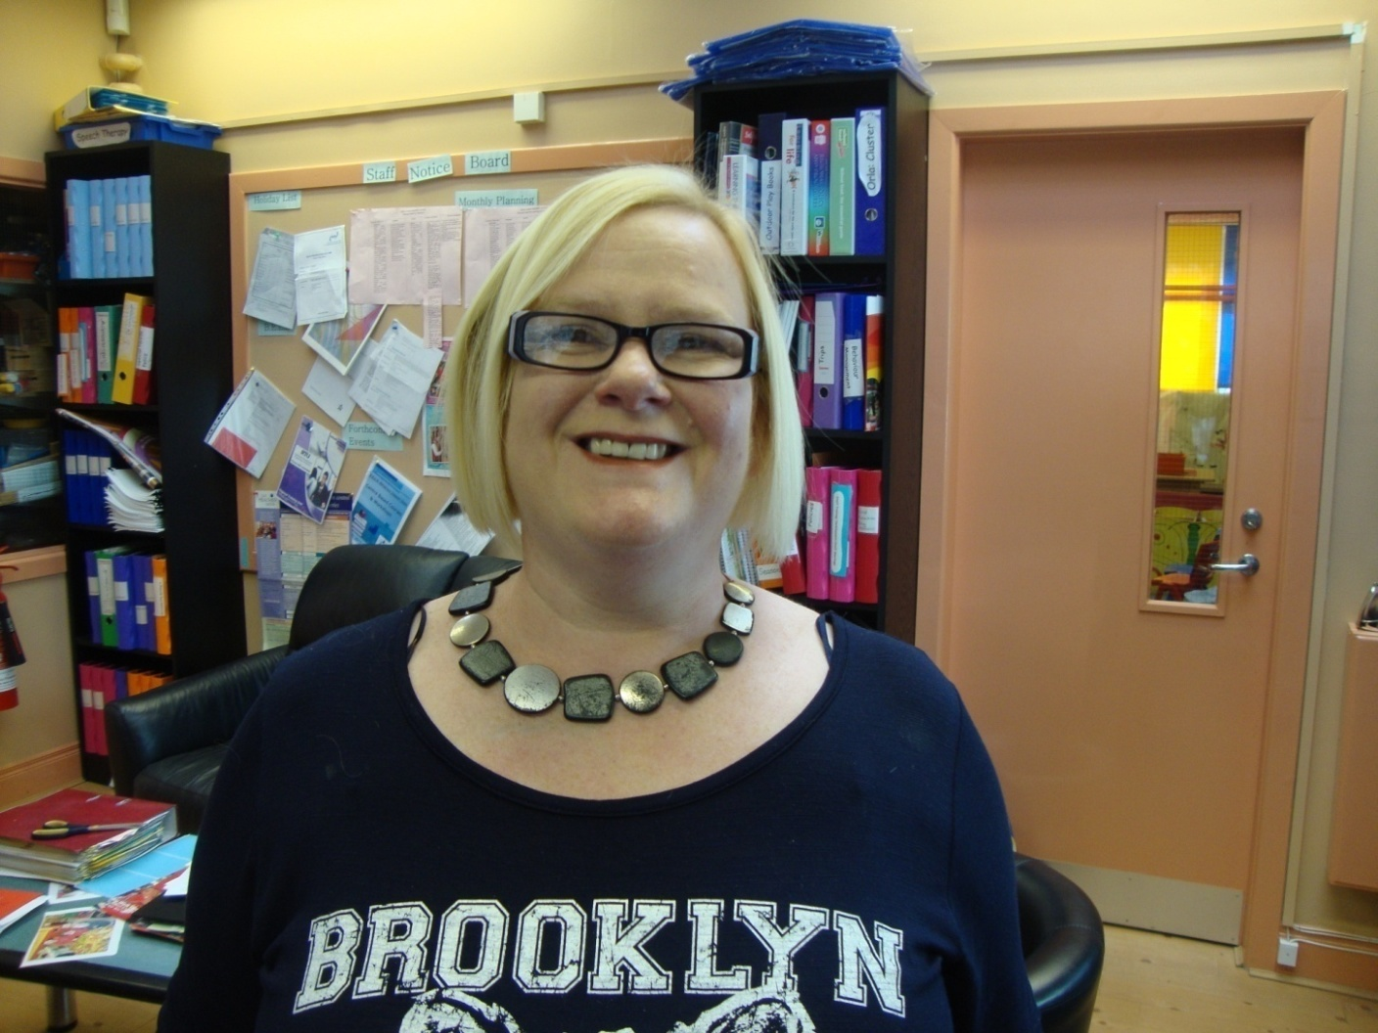
Mrs. Benson: Nursery Secretary

Slide 13
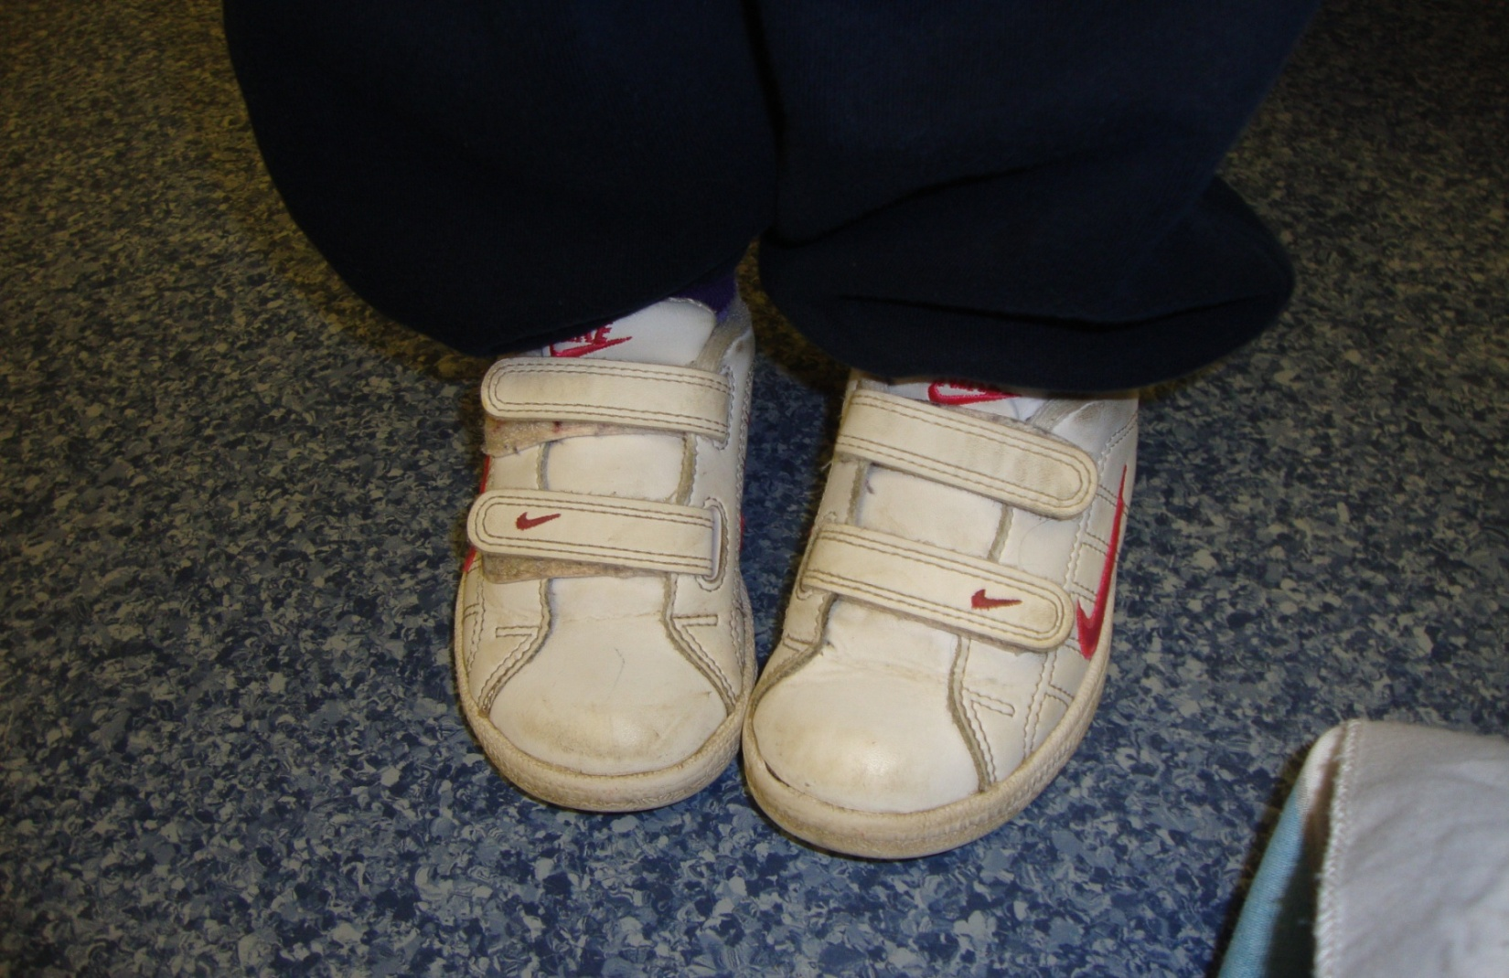
Shoes: Velcro trainers

Slide 14
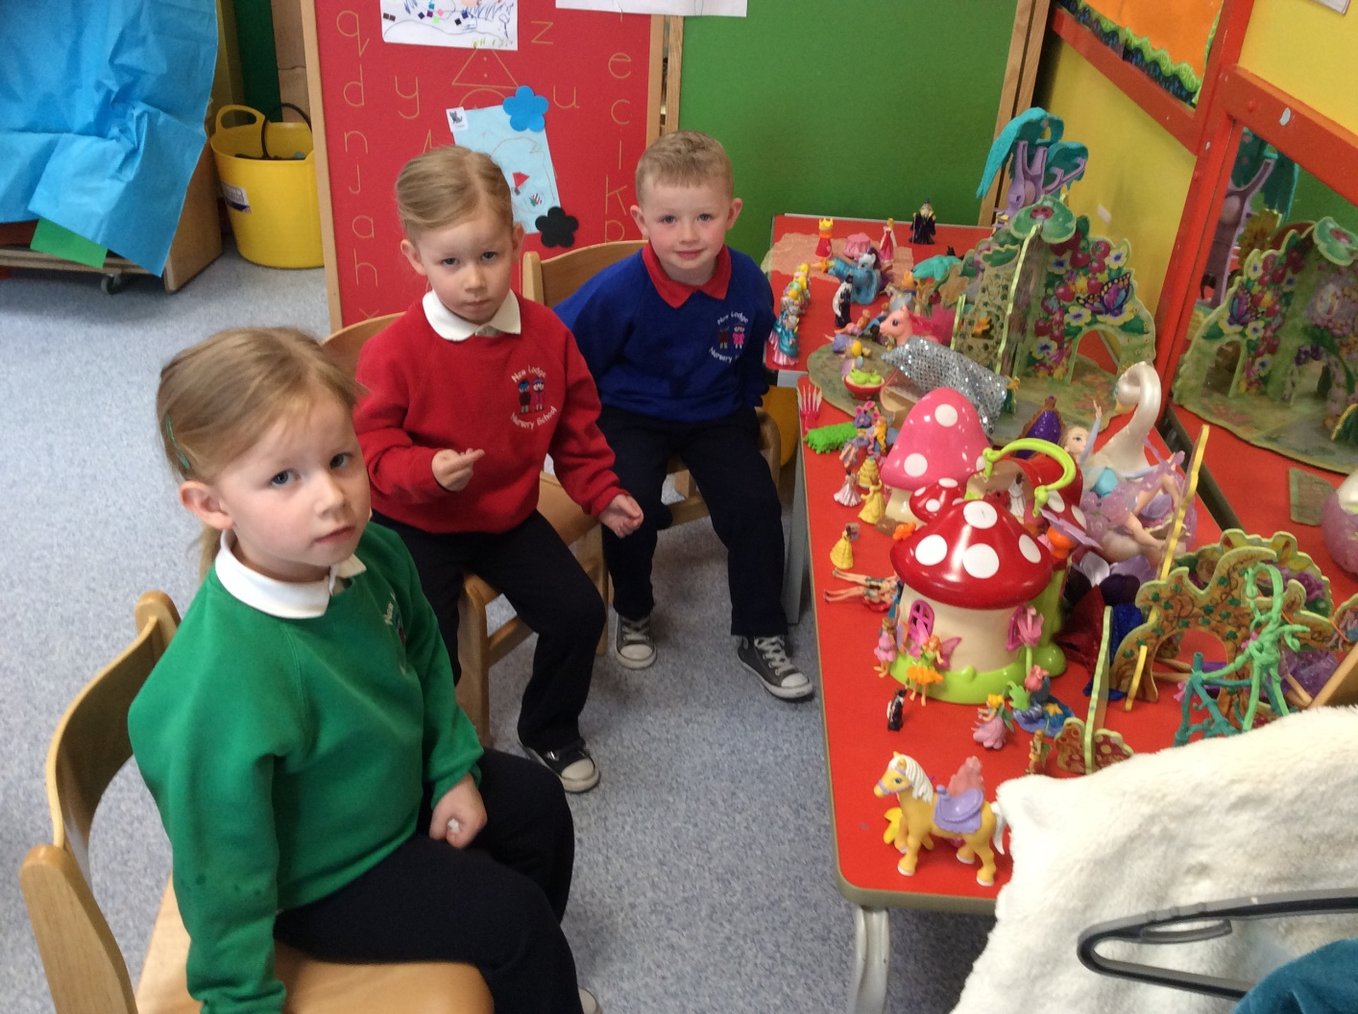
Uniform: Elasticated Trousers

Slide 15
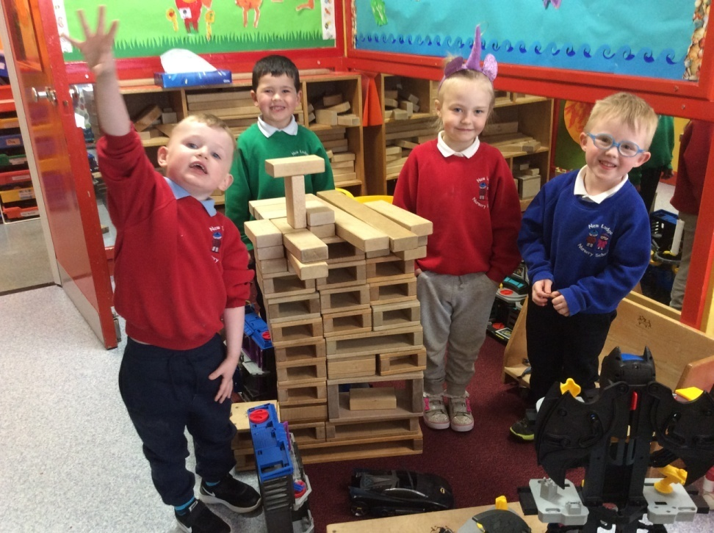
No Sweets, No Toys

Slide 16
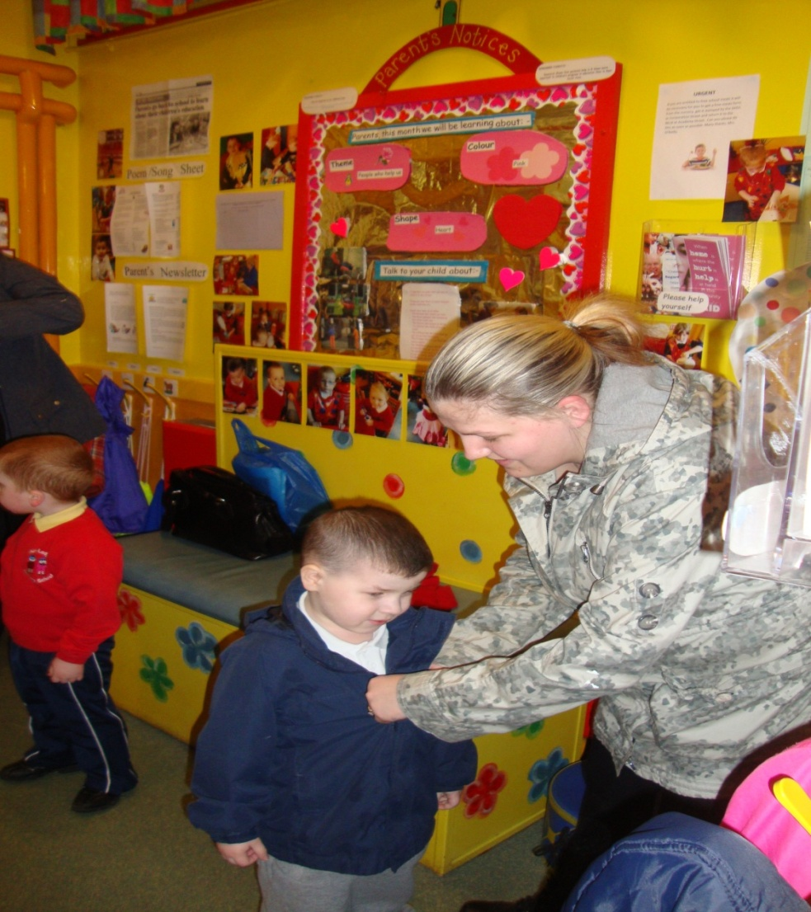
Collection of children

Slide 17
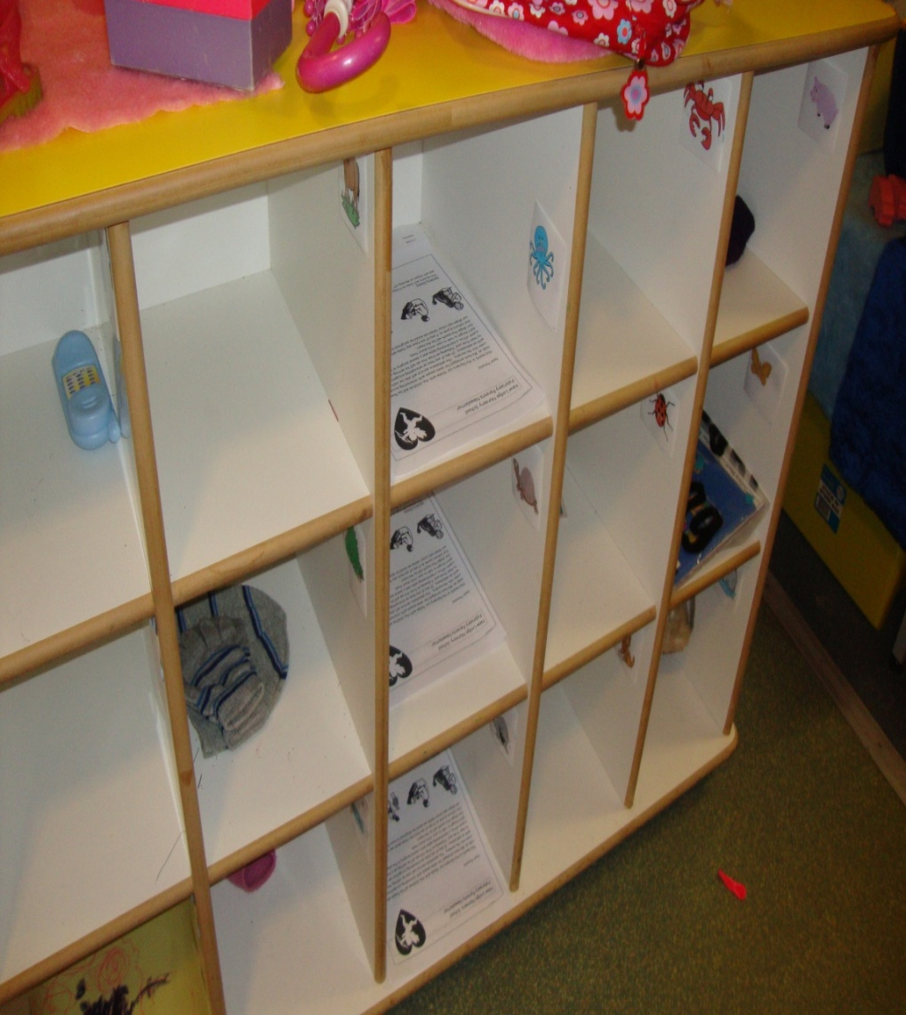
Collection of children

Slide 18
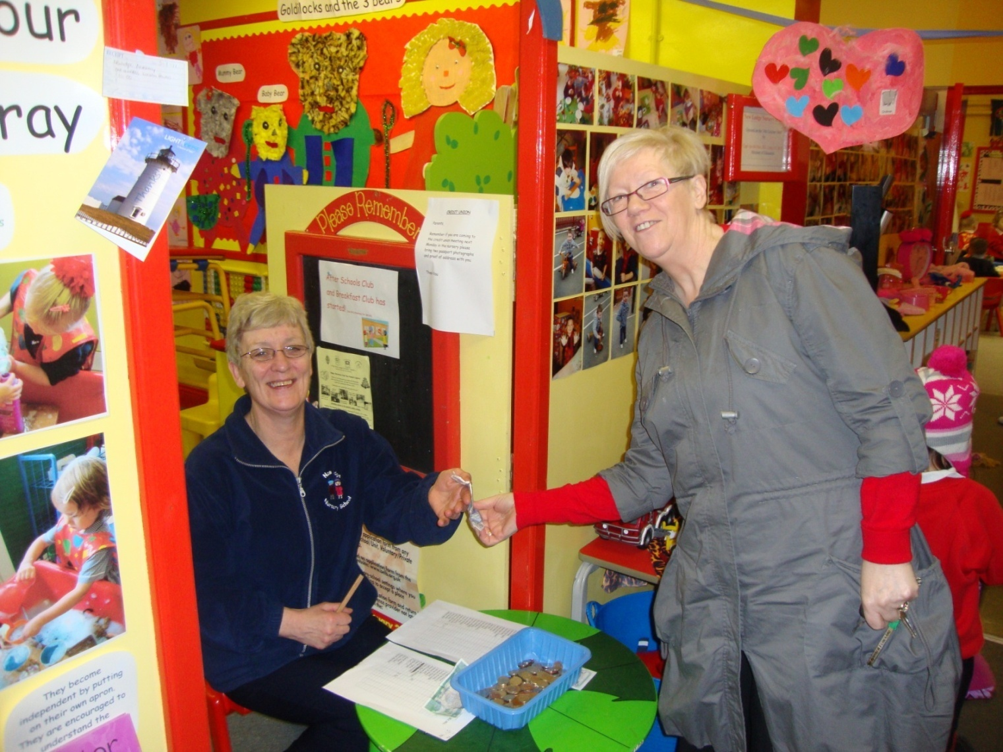
The Nursery Snack Fund

Slide 19
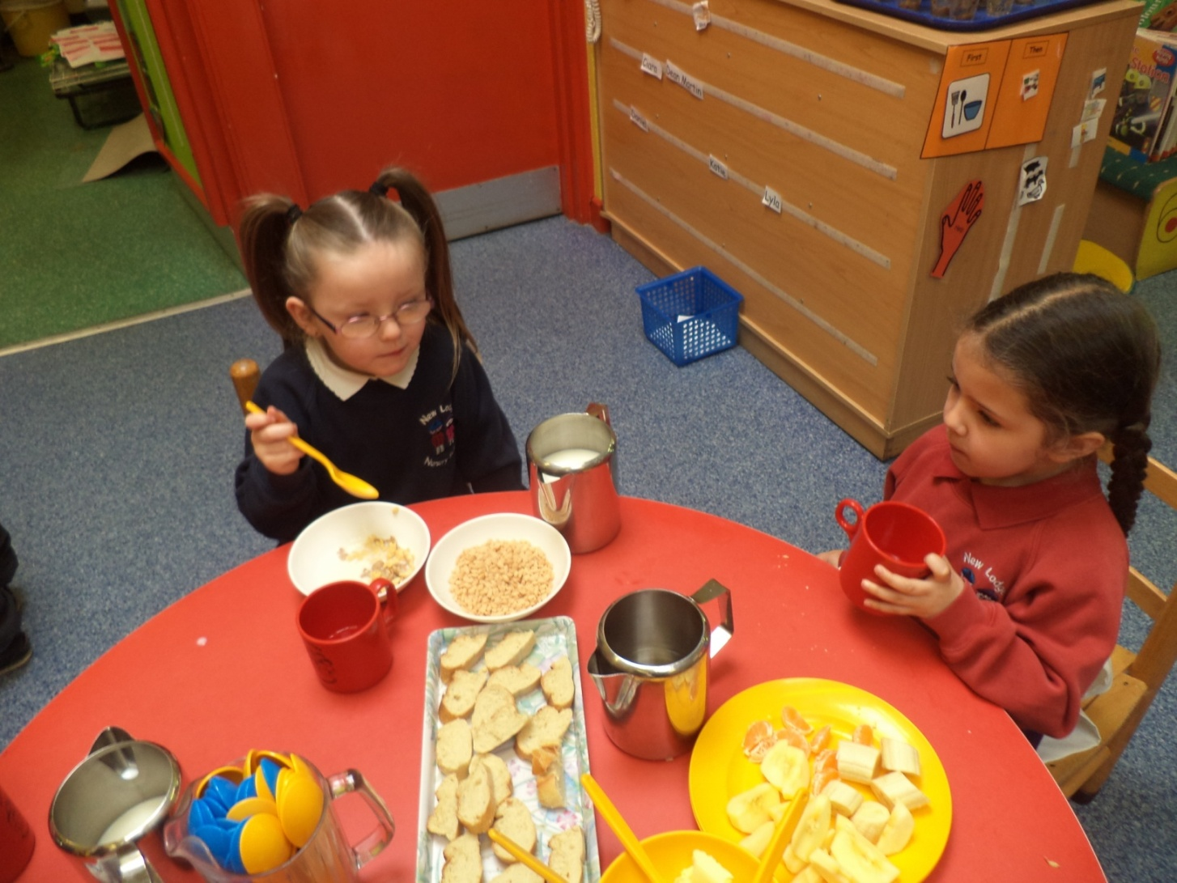
Morning Snack

Slide 20
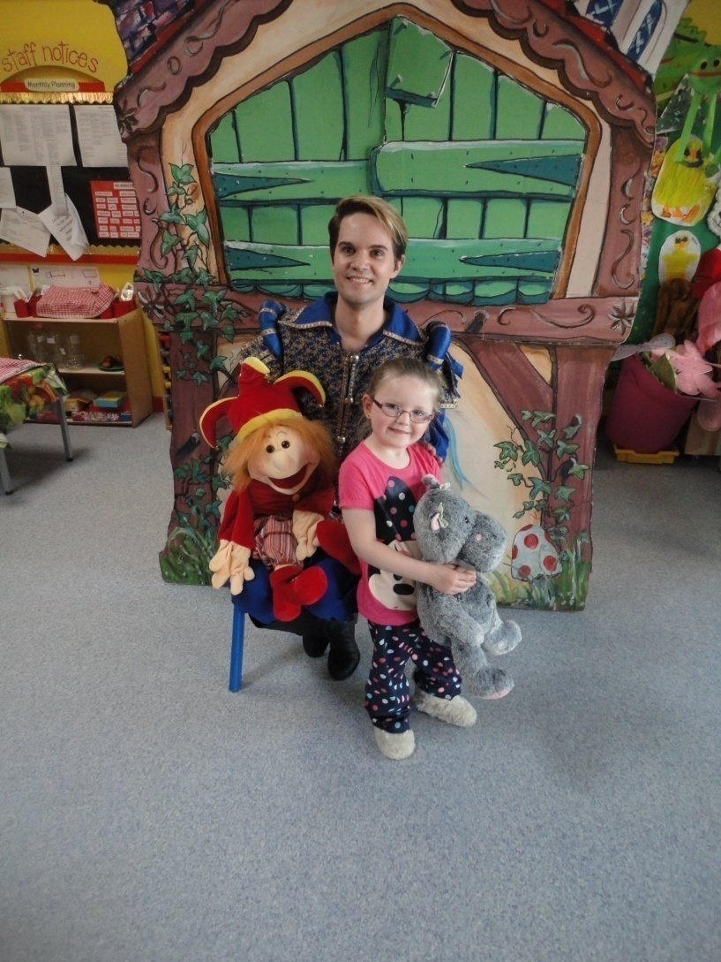
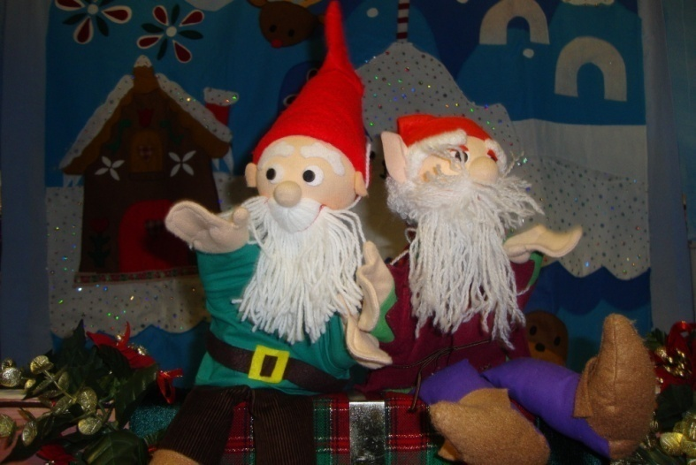
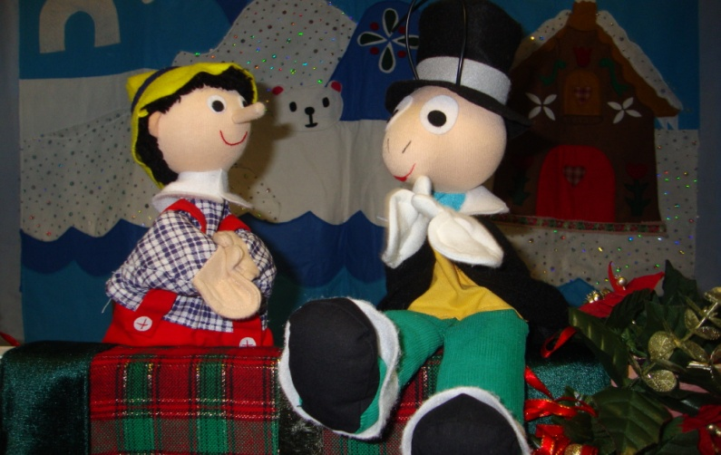
Visitors to the Nursery

Slide 21
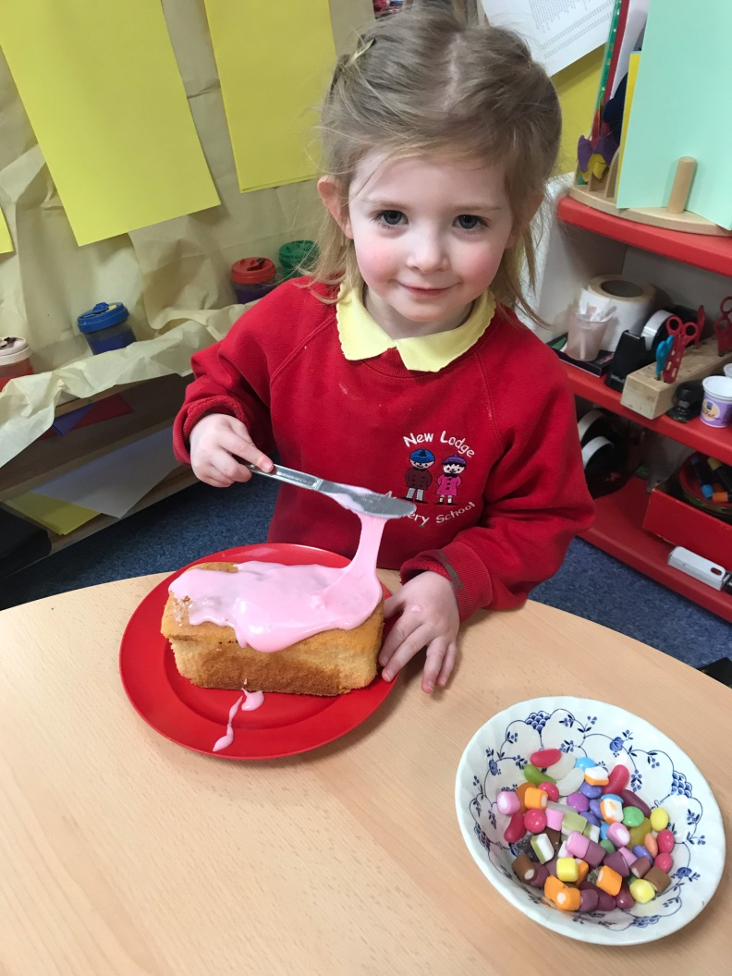
Birthday Cake

Slide 22
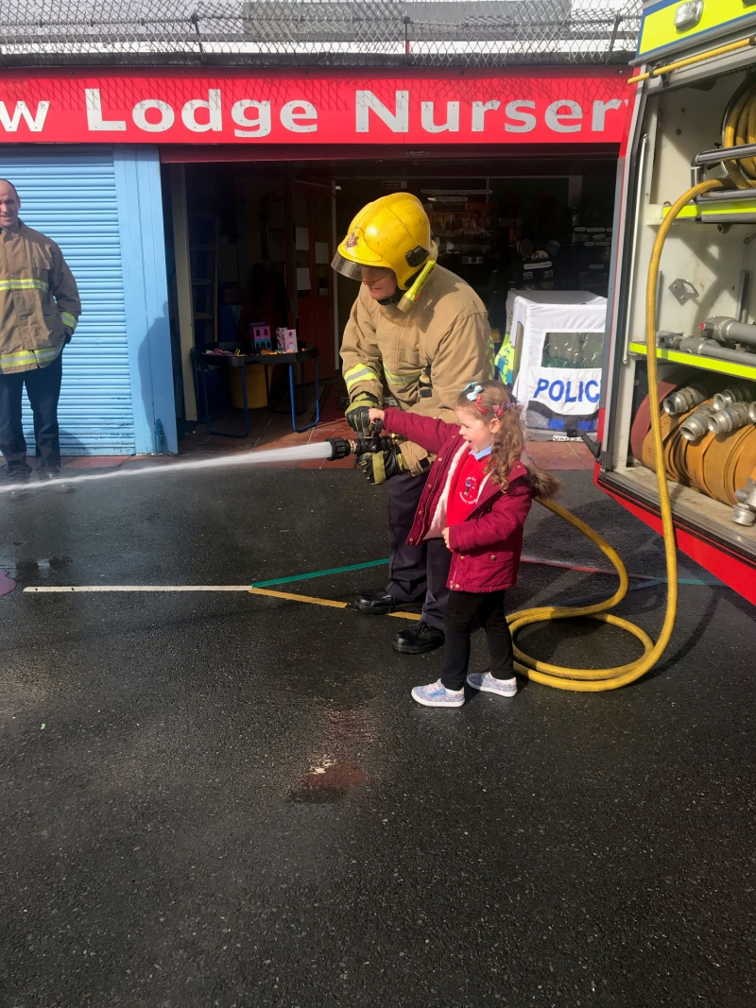
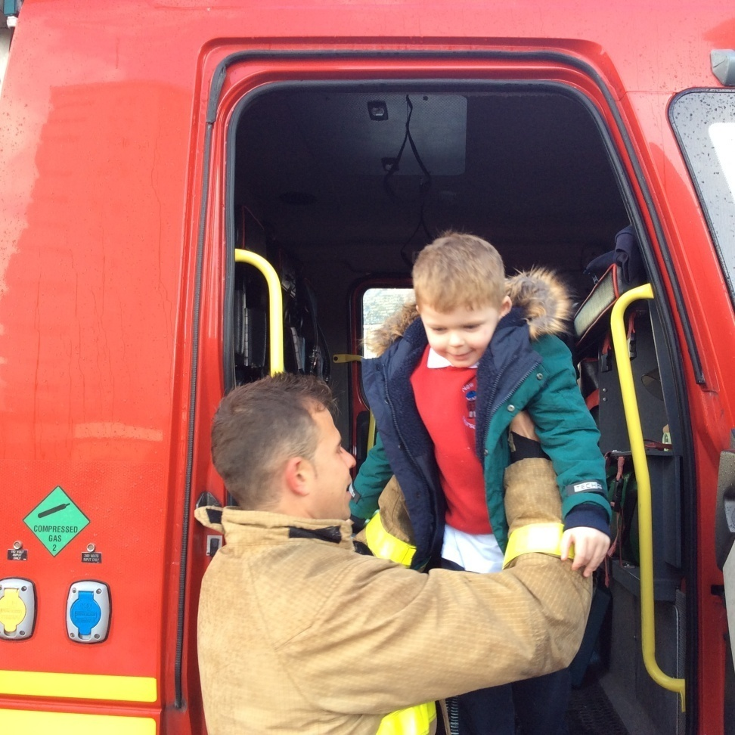
Visitors: The Fire Service

Slide 23
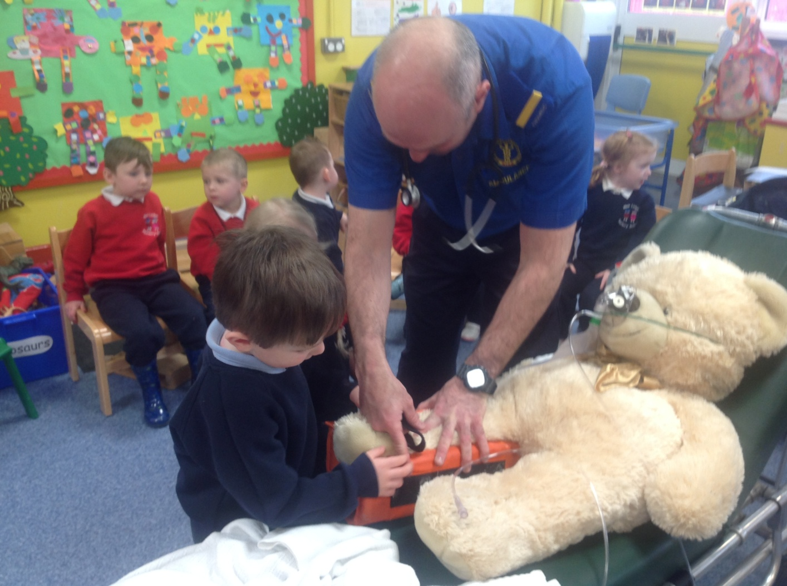
The Ambulance Sevice

Slide 24
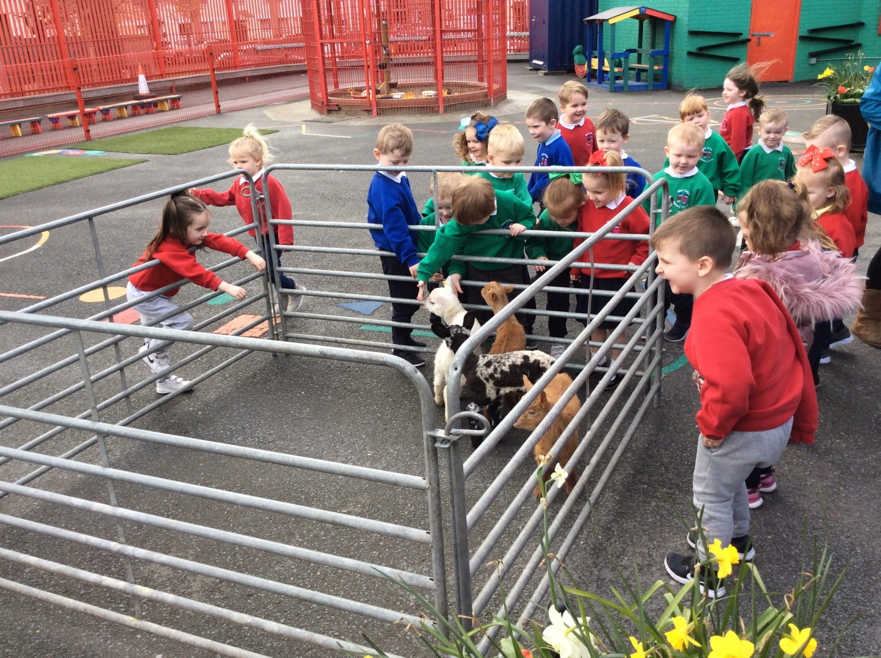
Visitors: Blackberry Farm

Slide 25
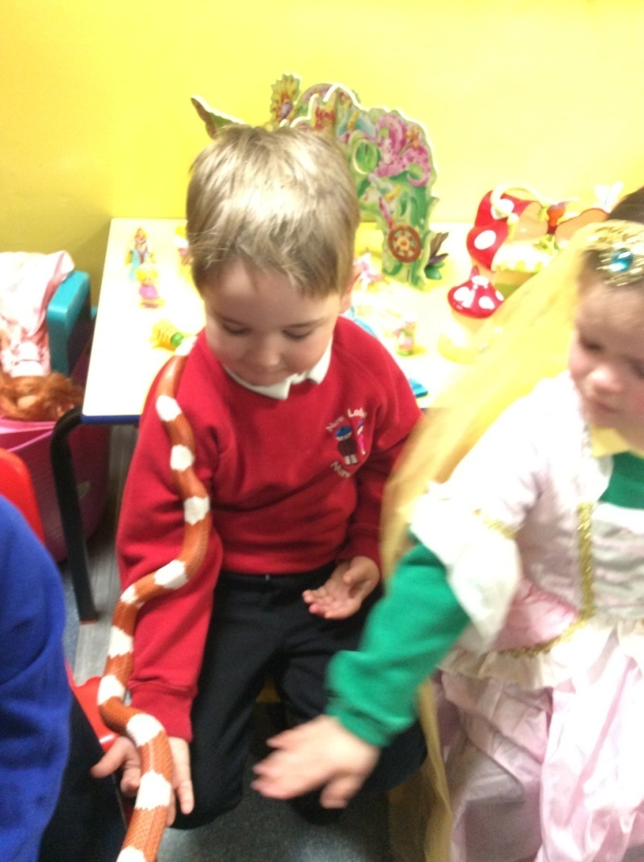
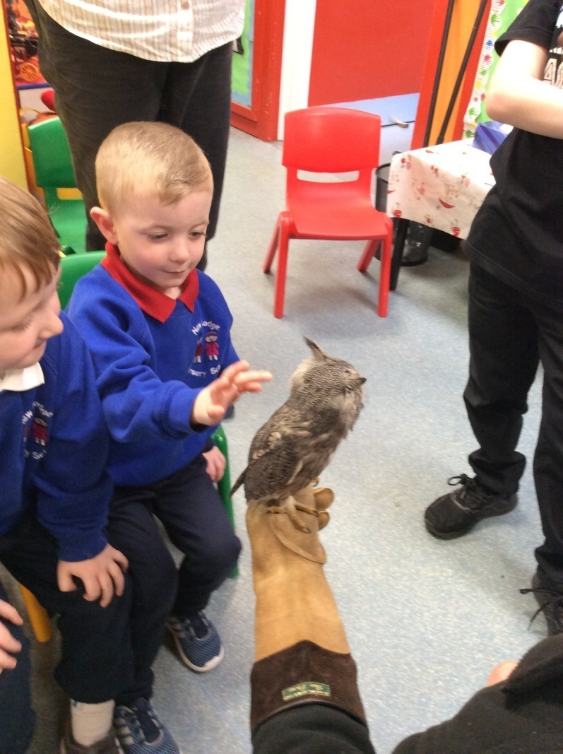
Visitors: Mantella Exotic Animals

Slide 26
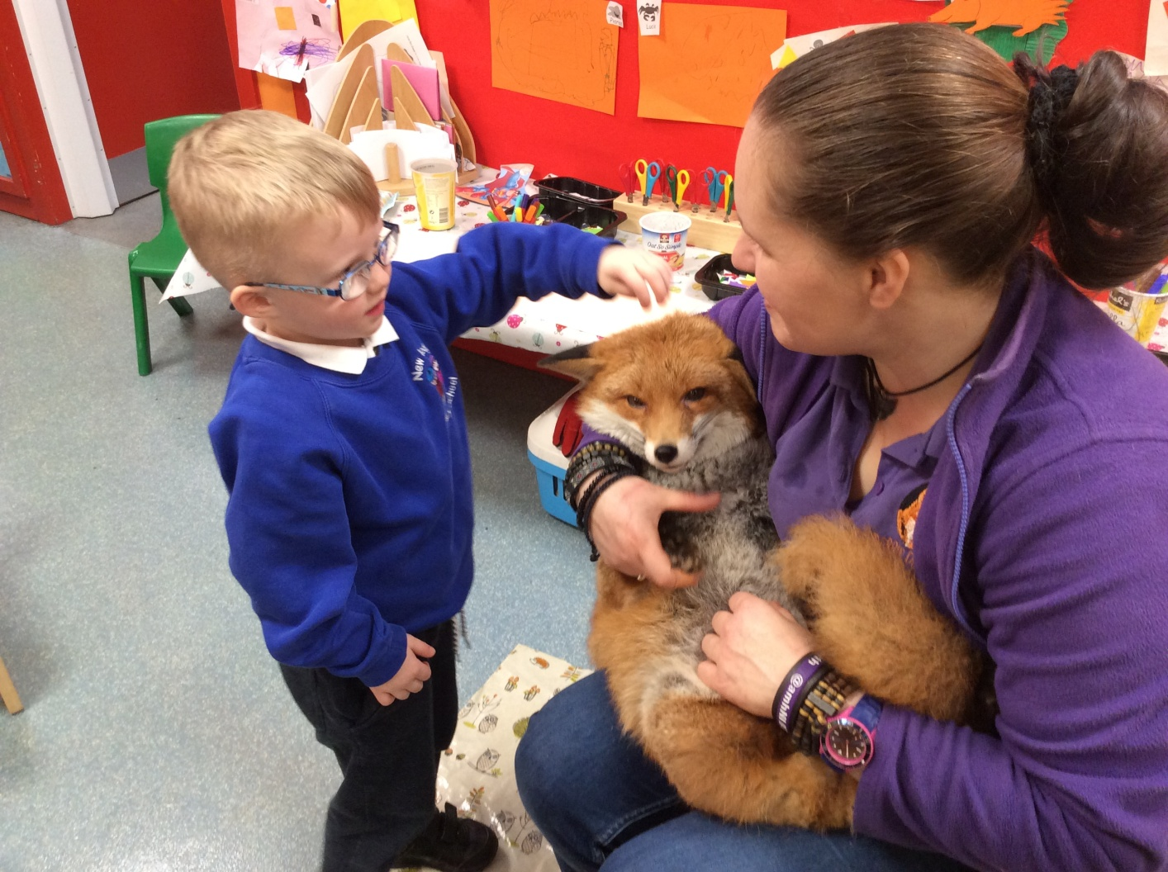
Visit of Tact and the Fox

Slide 27
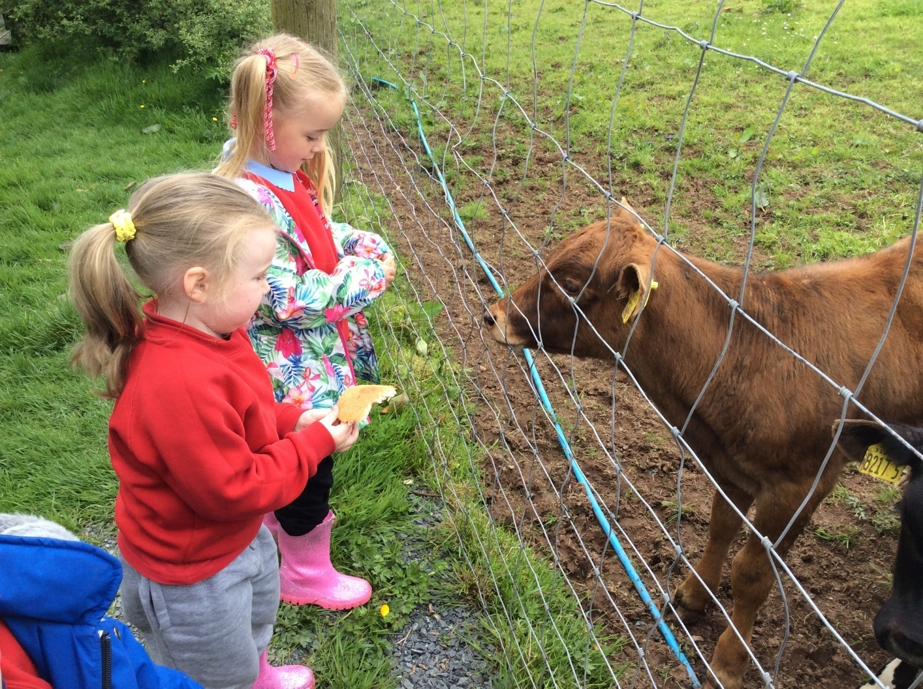
Visit to Streamvale Farm

Slide 28
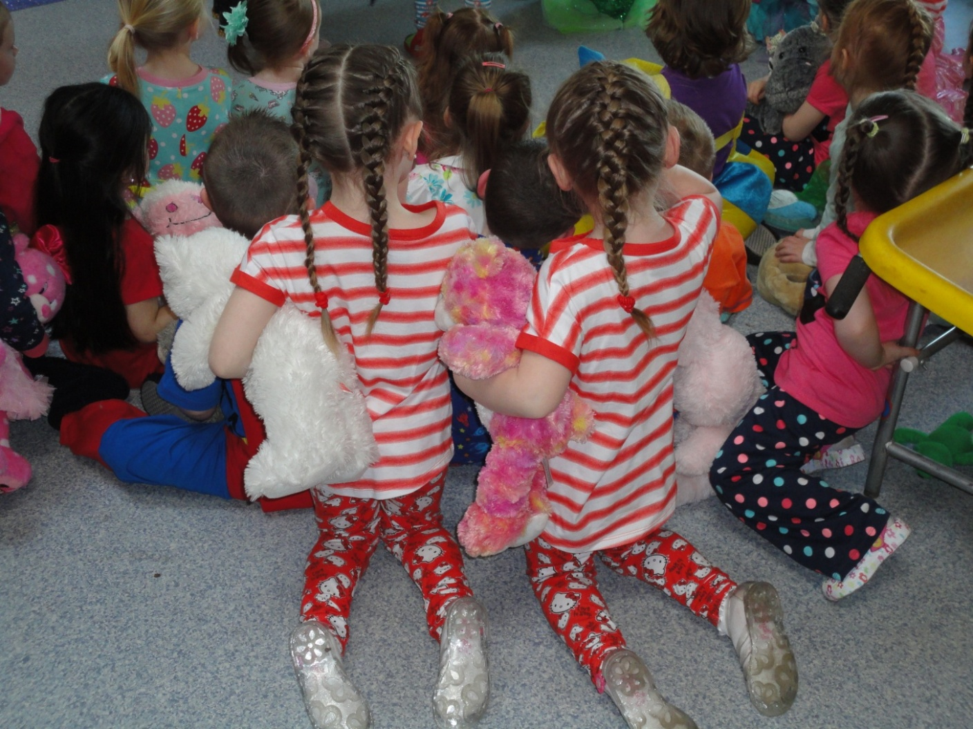
Our Pyjama Night

Slide 29
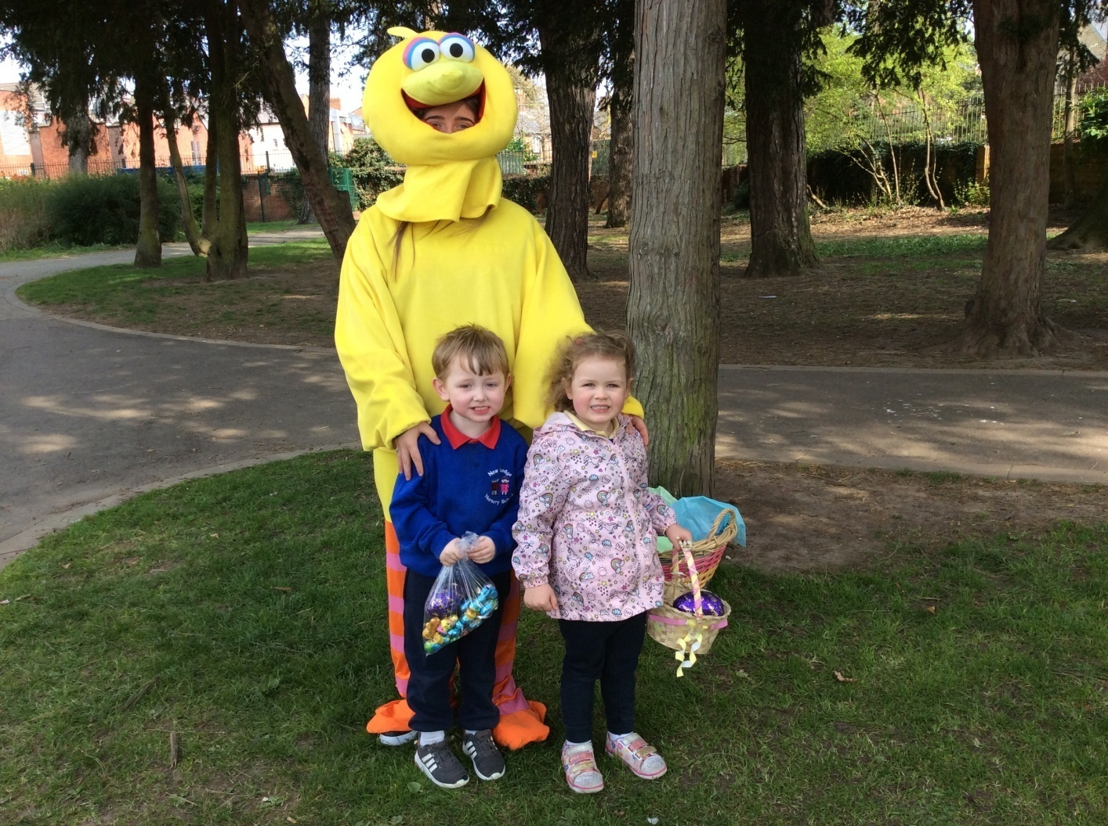
Easter Bunny Hunt

Slide 30
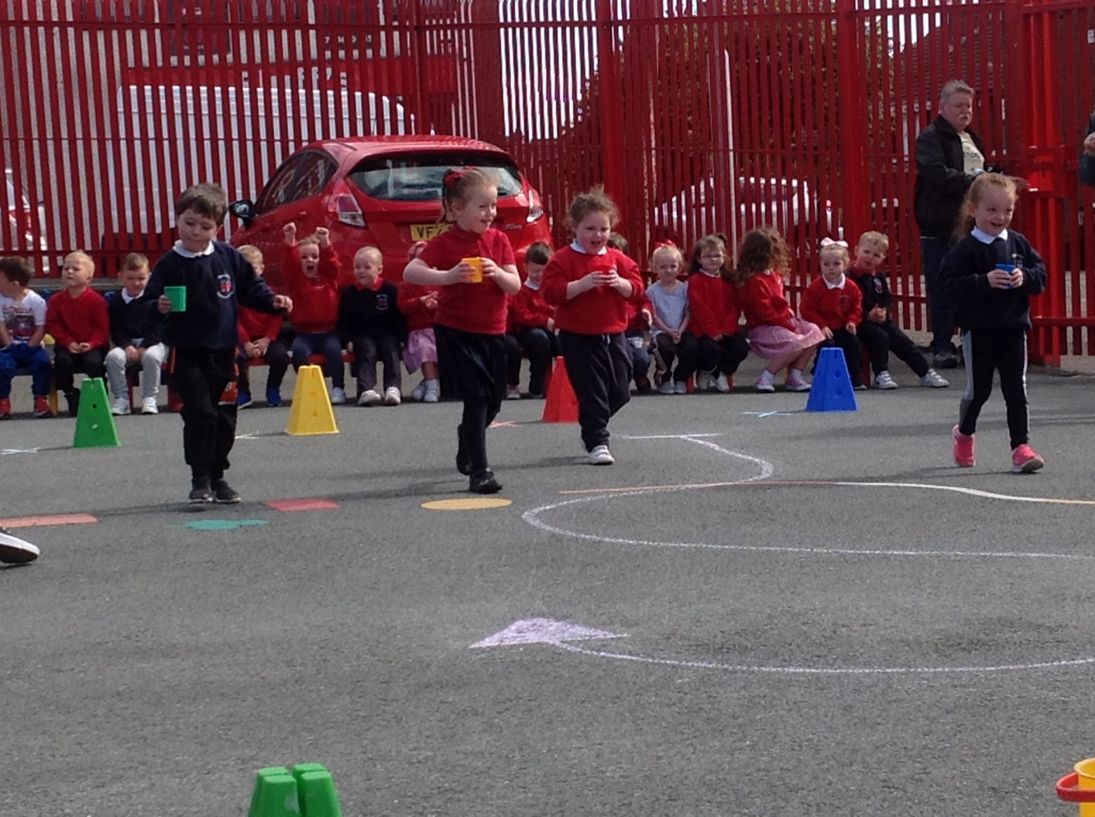
Sports Day

Slide 31
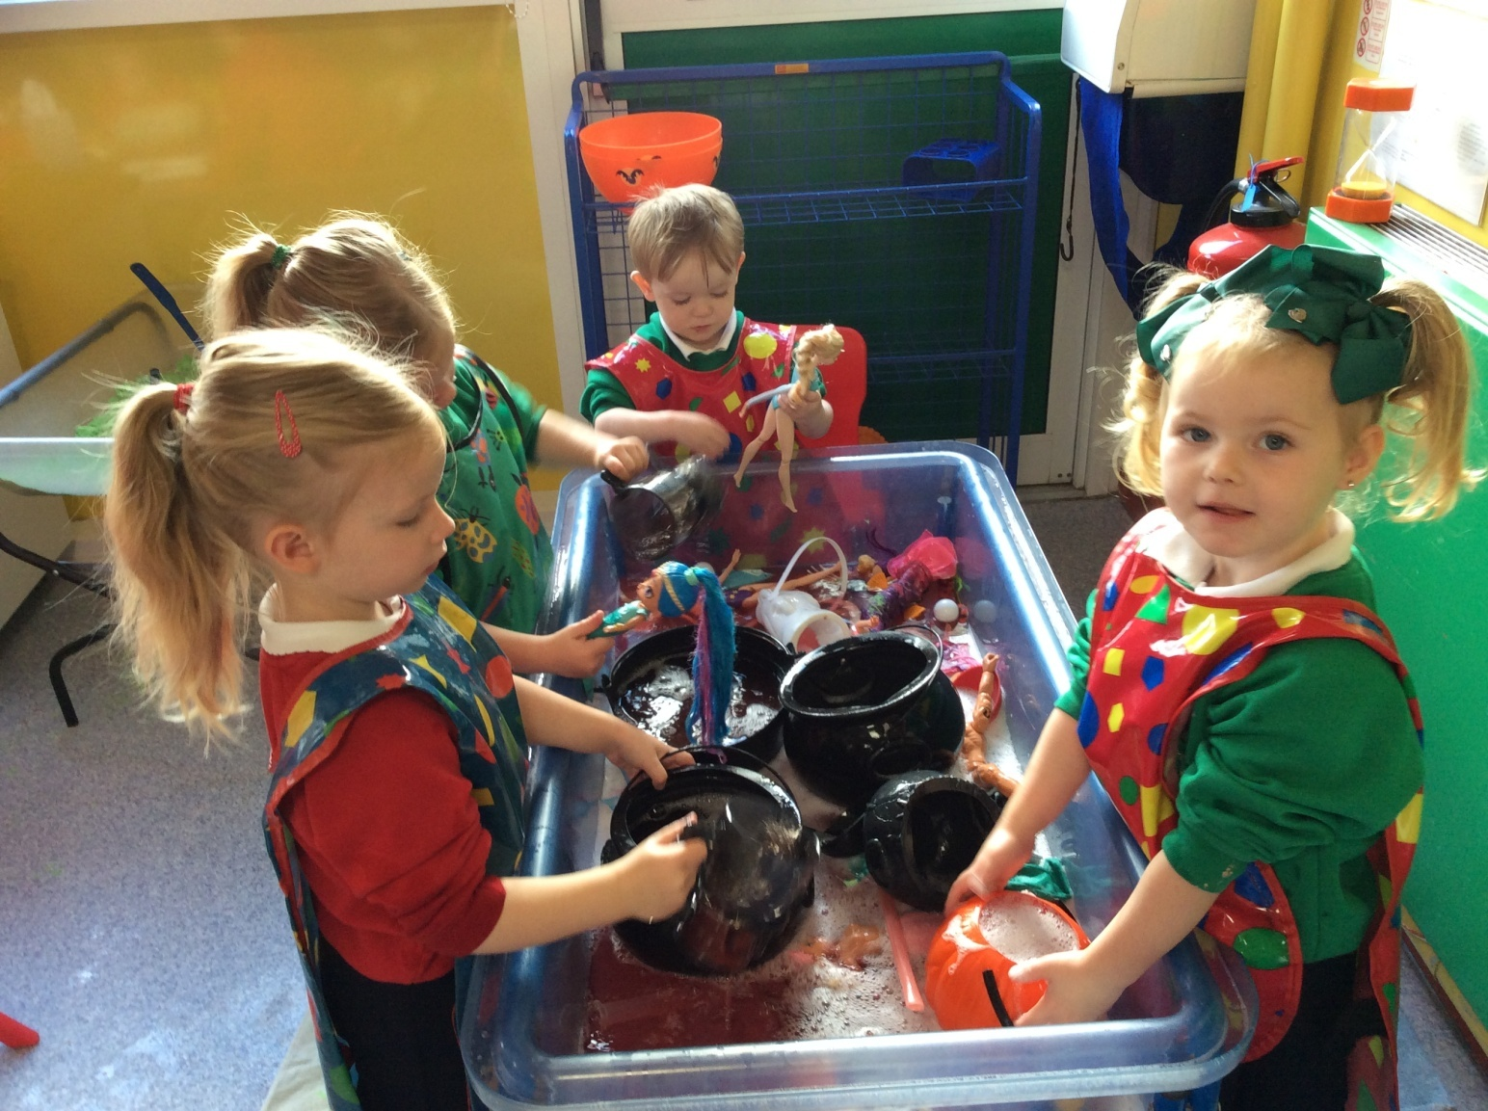
Personal Social & Emotional Development

Slide 32
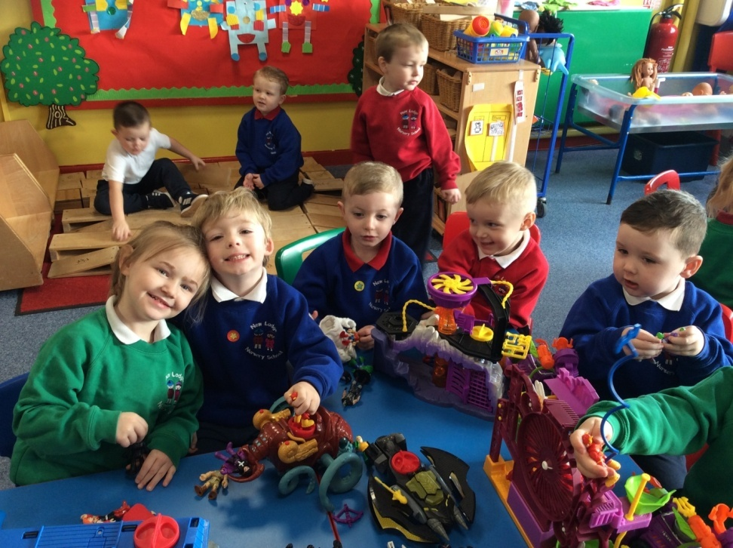
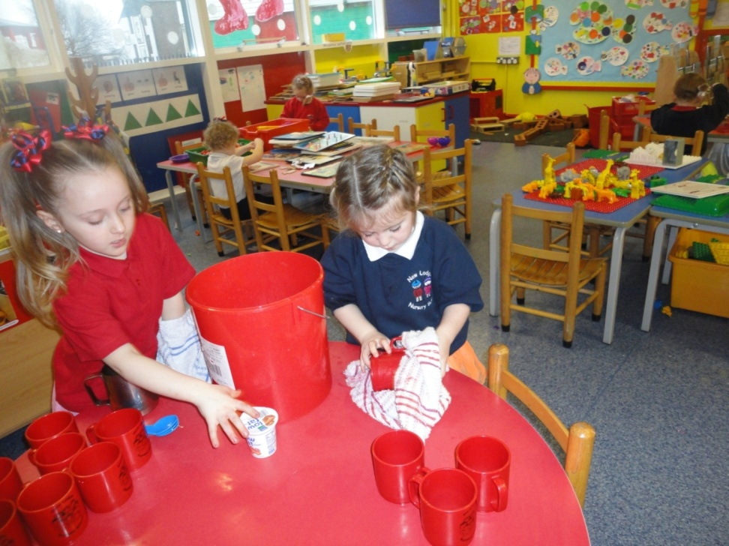
Personal and Social Development

Slide 33
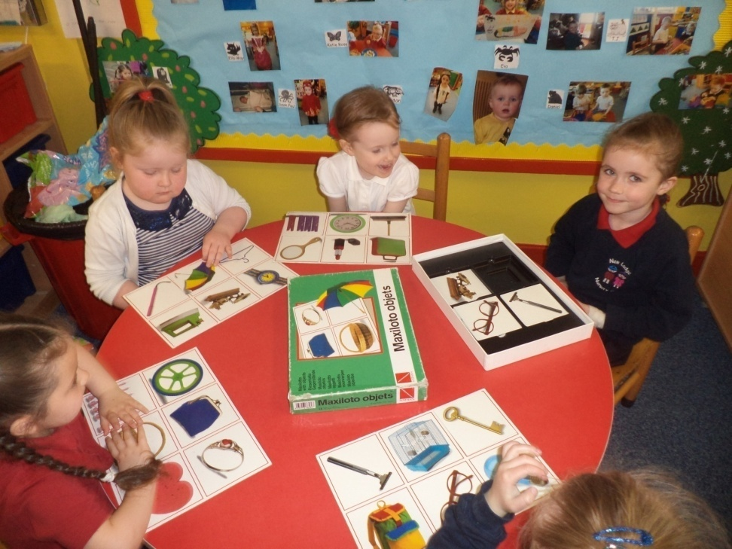
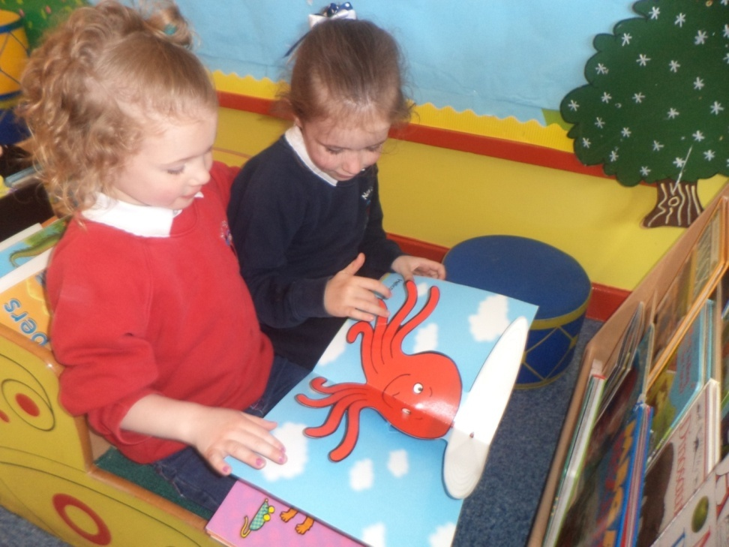
Language Development

Slide 34
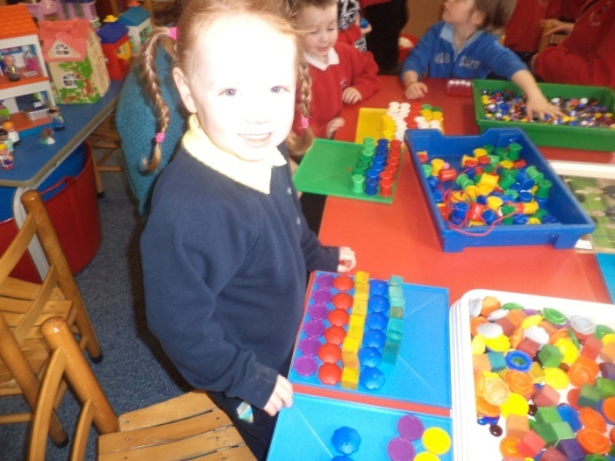
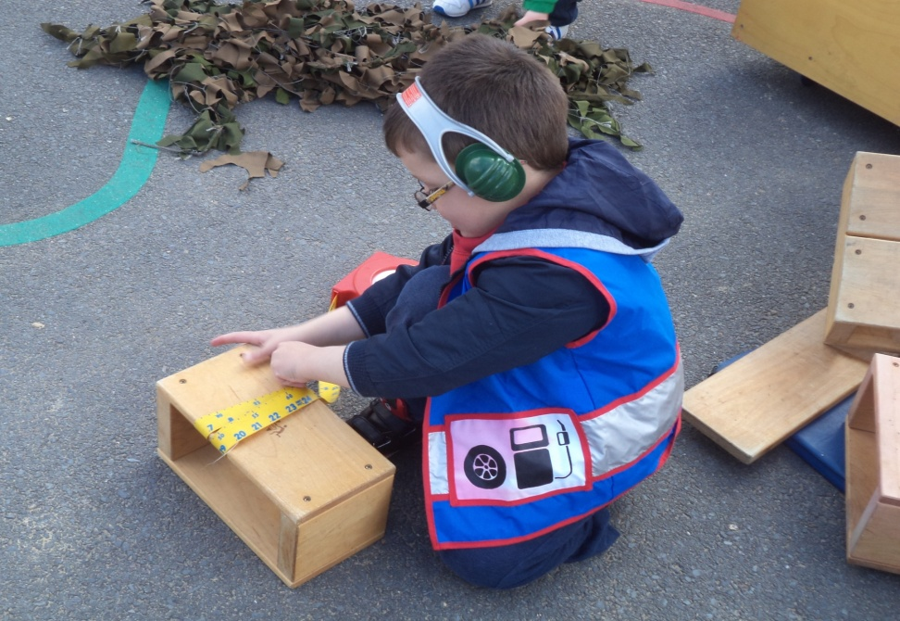
Mathematical Development

Slide 35
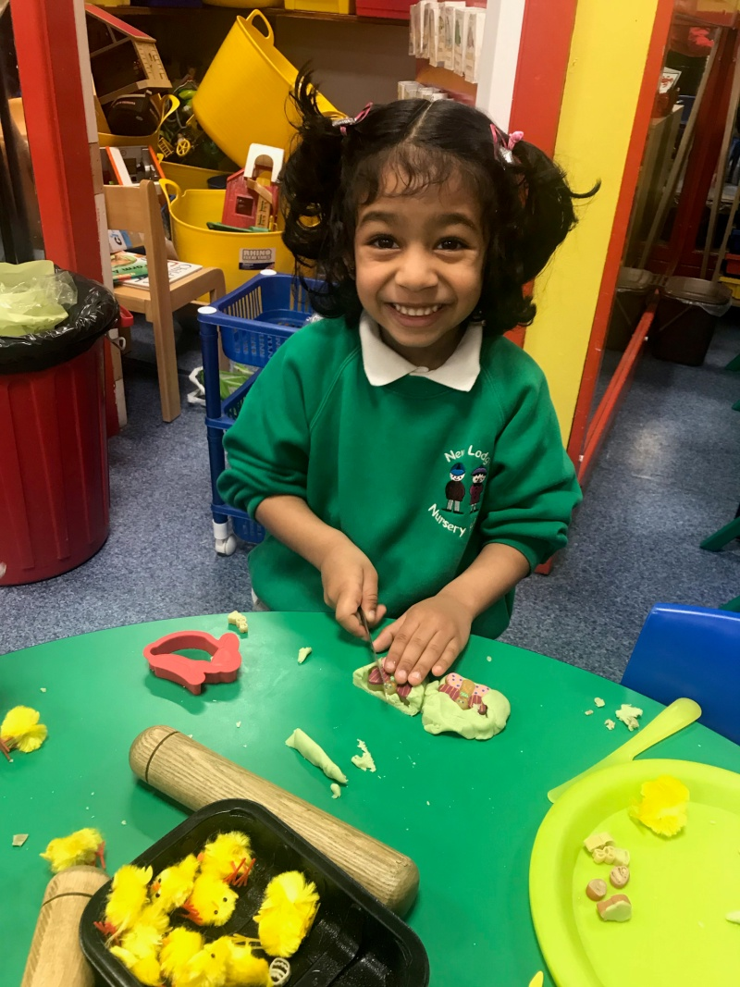
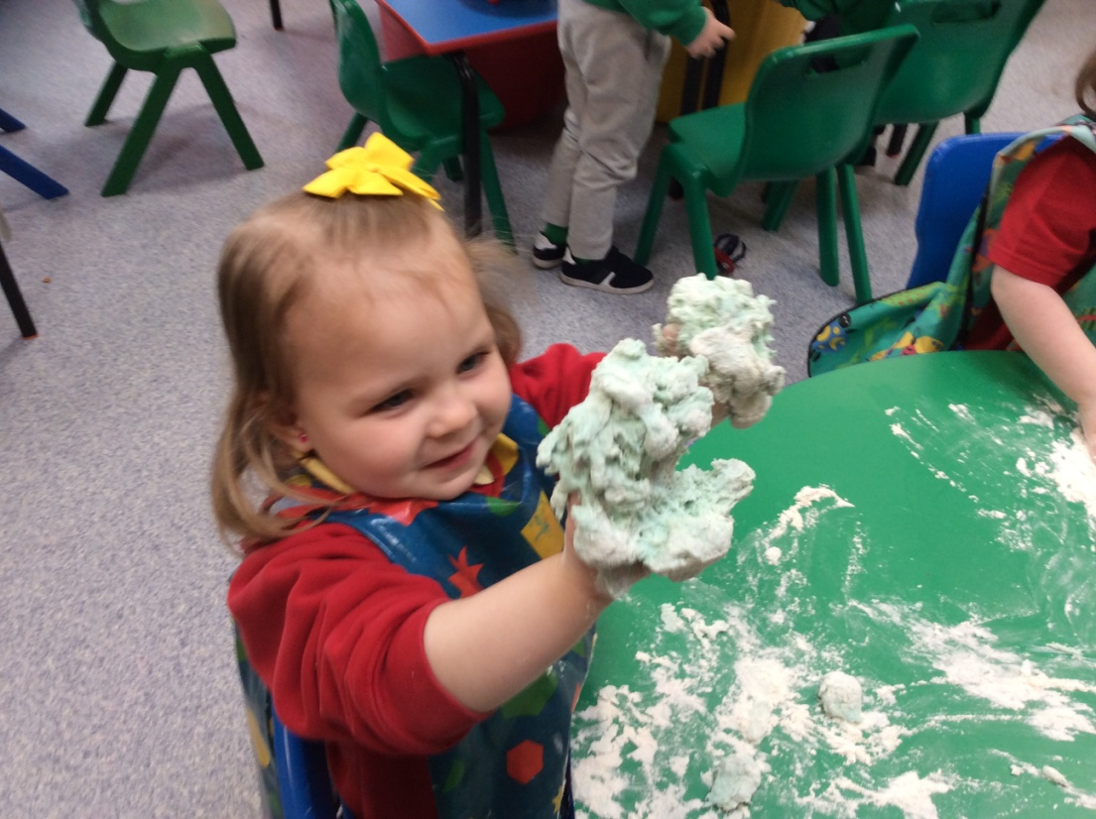
Creative Development

Slide 36
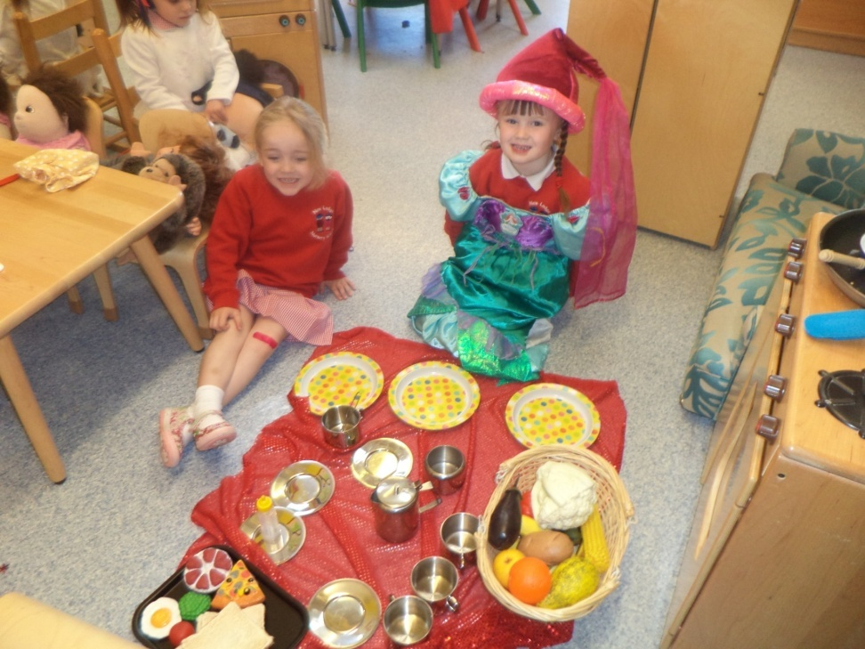
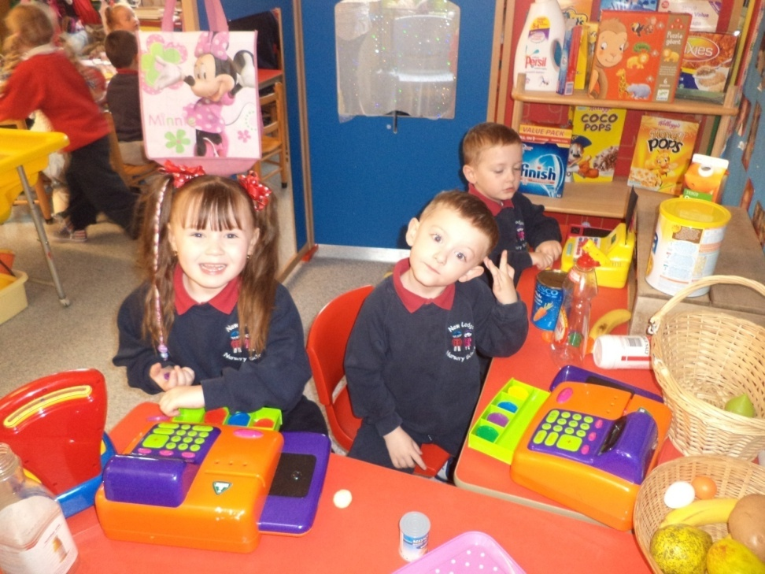
Creative Development

Slide 37
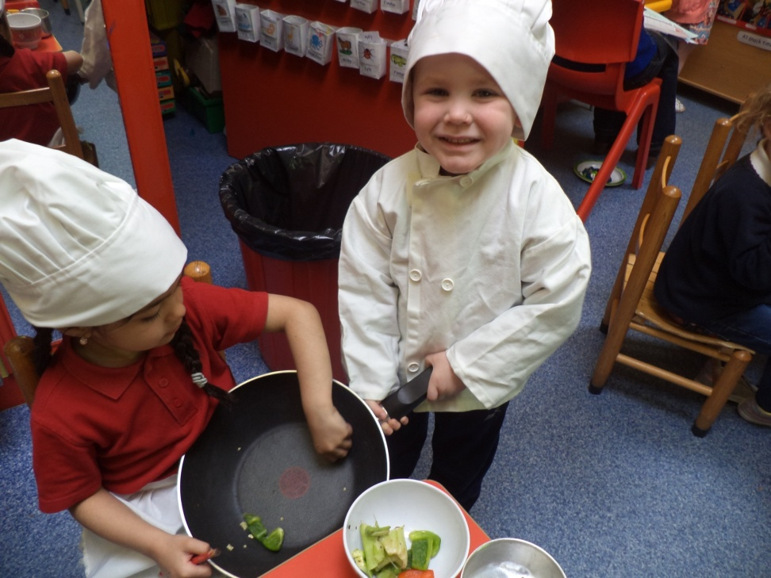
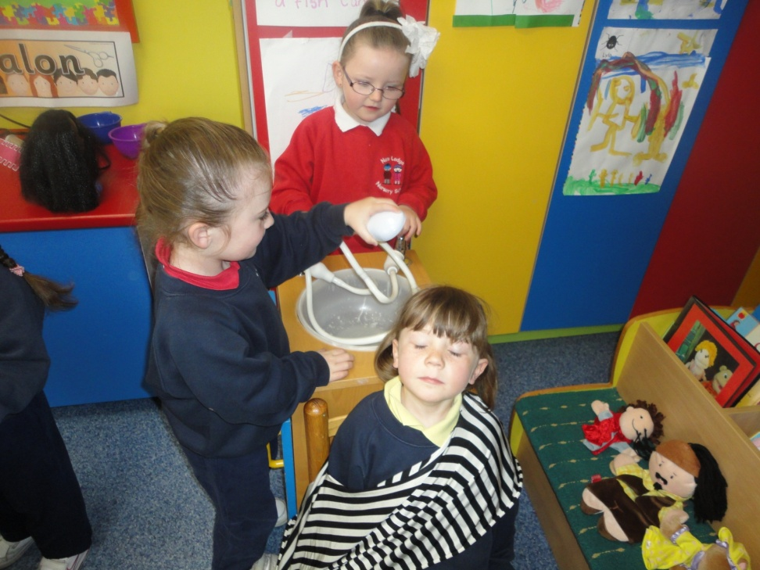
Creative Development

Slide 38


Creative Development

Slide 39

Physical Development

Slide 40

Physical Development

Slide 41


Physical Development

Slide 42

The world around us

Slide 43

The world around us

Slide 44

The world around us

Slide 45

The world around us

Slide 46


Cooking

Slide 47

Cognitive

Slide 48

Dinner Time

Slide 49

Dinner Time

Slide 50

Dinner Time

Slide 51

Behaviour Management

Slide 52

Child Protection/Safeguarding Policy

Slide 53
Observations
We are constantly observing the children and evaluating their progression in order to plan effectively for their needs.

Slide 54

For September I need to bring in

Slide 55

Settling in policy

Slide 56

Settling in policy

Slide 57

Settling in policy

Slide 58
How to prepare your child for Nursery School
Look at the nursery book with your child, talk about the teachers names and all of the activities they will be doing in nursery.
Increase their independence by letting them do more for themselves toileting, dressing, tidying up.
Read books and talk about the pictures.
Help them draw, colour in cut with scissors.
Talk, Talk Talk and Talk some more to them.

Slide 59

The nursery/home partnership.
How can you help?

Slide 60

Reading the parent noticeboard.

Slide 61


Slide 62


Slide 63


Slide 64
New Lodge Nursery School
January Parents Newsletter
Dear Parents,
This month in the Nursery the children will be talking
About “Winter”. There will be a series of display tables in the hall
for the children to look at and touch and we would encourage you
to spend a bit of time looking at them with your child. In the hall
we will have a “white” display table and a “square” table, the colour
and shape that we will be concentrating on in the next few weeks.
We will also have a winter clothes table and a ‘pairs’ table. As
part of our “winter” topic we will be talking about the changing
weather and the winter clothes we need to wear and will be
emphasising words such as chilly, nippy, freezing, slippery,
condensation, snug, layers, waterproof and fur.
We will be talking to the children about looking after the birds
in winter-so start saving those crusts for our bird table!
With the darker mornings and earlier nights we
will be talking to the children about safety on the roads in
Wintertime.

Slide 65


Slide 66

Reading the monthly newsletter and poem sheet.

Slide 67


Slide 68


Slide 69

Look in your child's box daily.

Slide 70


Help your child hang up their coat at their symbol and make sure that a change of clothes is always available in your child’s bag.

Slide 71

Coming into the nursery to help.

Slide 72


Slide 73

Parents in Class

Slide 74
Important !
Make sure you have a copy of 2 booklets
LOOK inside the book for your child’s details
Check their symbol
Their teachers
Their starting date
Inside there is a loose page which gives a date and time for your home visit
Contact us if your address has changed of if this date does not suit you due to holidays etc

